Slide 1
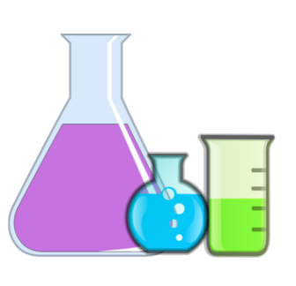
Chemistry
Mixtures

Slide 2
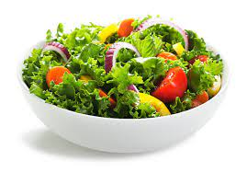
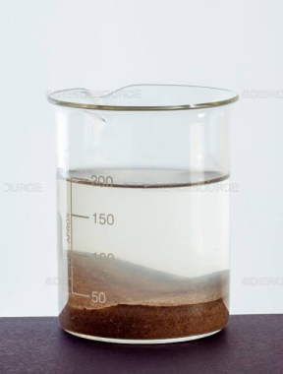
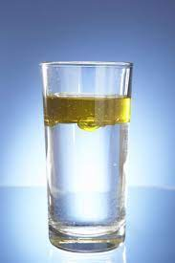
Mixtures can be made by :
Mixing two solids together, sometimes it can be easily separated.
Examples: a bowl of salad.
Mixing a solid and a liquid together.
Example:
Sugar in water
Sand in water.
Mixing two liquids together.
Water with oil

Slide 3
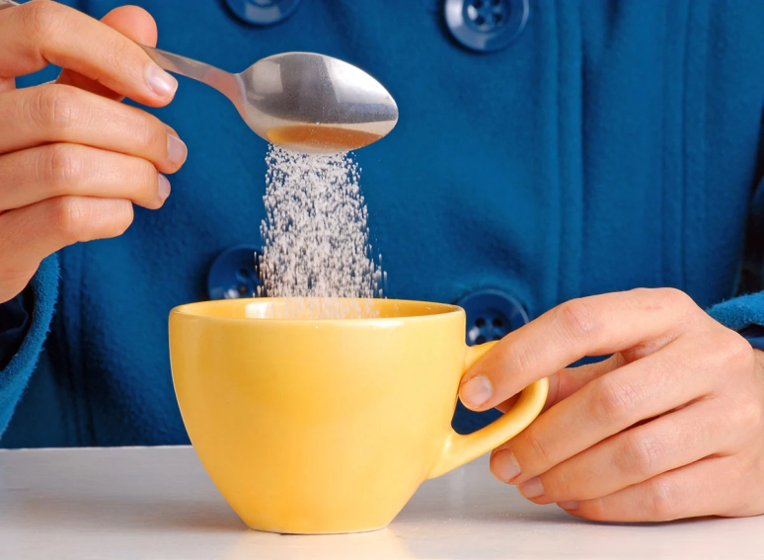
Dissolving
Tea is a liquid. Sugar is solid. When you put sugar in your tea and stir it, the sugar seems to disappear.
You know the sugar is there because you can taste it in the tea. What happened to the sugar?

Slide 4
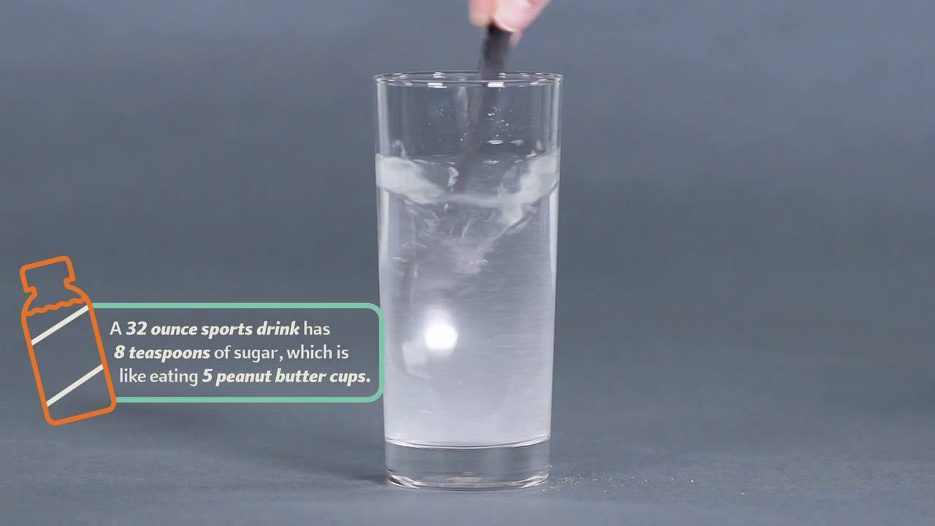
The sugar has dissolved in the tea. This means that the particles of sugar have spread out into the spaces between the particles of the tea forming a solution.

Slide 5
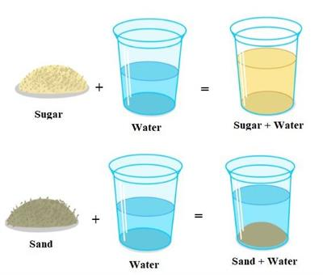
Solids that can dissolve in a liquid are called soluble solids.
Not all solids can dissolve. These solids are insoluble.

Slide 6
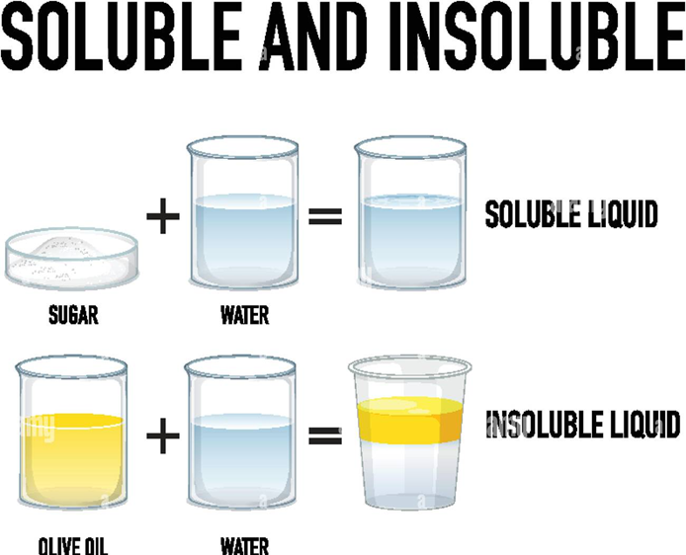
Dissolving is a type of mixing.
We call the mixture a solution.

Slide 7
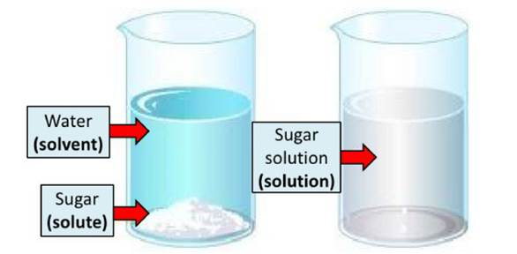
The solid in the solution is called the solute, for example, sugar.
The liquid is called the solvent,
A solution will always contain a solute and a solvent.

Slide 8
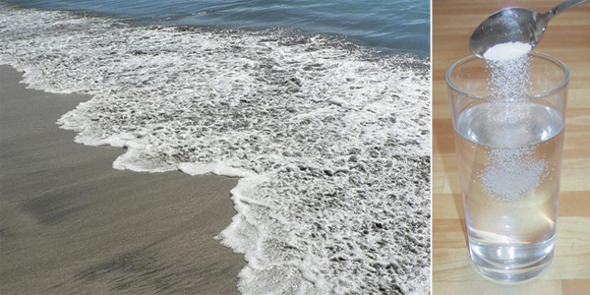
Sea water is another solution. The salt dissolves in the water to make the solution. The salt is the solute and the water is the solvent.

Slide 9
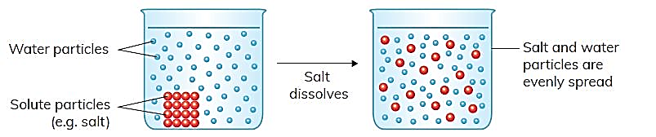
The particles of the solute move between the solvent particles when they dissolve.
The solute particles spread evenly in the solvent.
We say that a solution has a uniform appearance.
This means that it looks the same throughout. The picture shows how the solute particles spread when they dissolve in water.

Slide 10
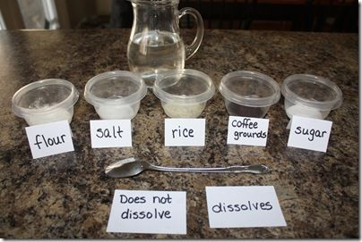
Many substances dissolve in water. This is another one of water’s properties. Water is sometimes called the universal (common) solvent because so many substances can dissolve in water.

Slide 11
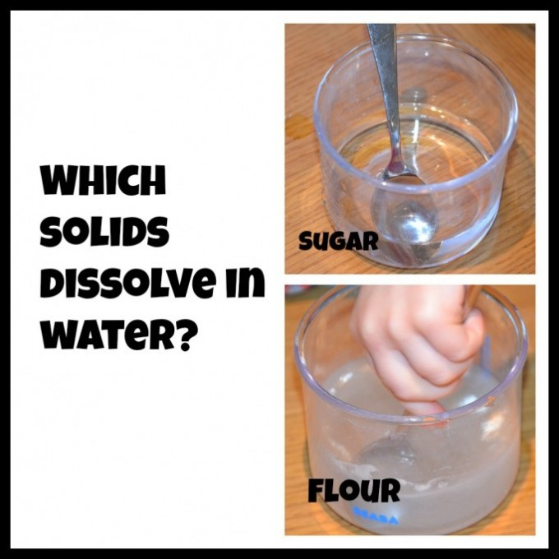
Suspension
When solid does not dissolve in a
liquid It can form:
1- A suspension which is
cloudy and you can see the
floating solid particles through out
the liquid.
Example:
- Flour in water.
- Mud in water
2- Insoluble
Example:
sand drops down at the bottom of the liquid so sand in insoluble.

Slide 12
Separating a solution
A solution is a mixture of the solute and the solvent. We can separate most mixtures because the particles of the substances in the mixture are not chemically joined together.
(Not permanent not chemical not irreversible change)
Can we separate a solution?
Yes, Because It is reversible temporary physical change.

Slide 13
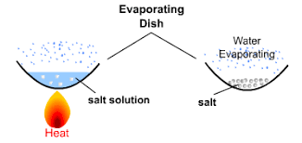
We can separate the dissolved solute from a solution by evaporation.
We call this a reversible process because we can get back the dissolved solute from the solution.

Slide 14
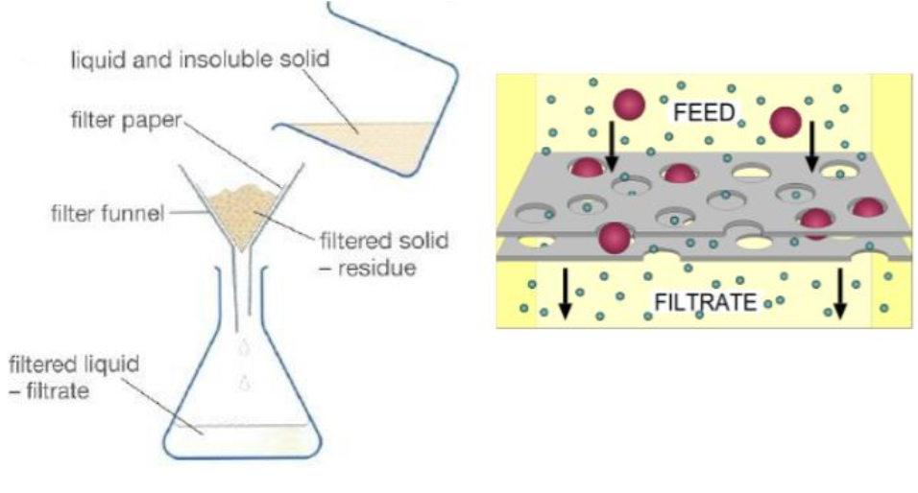
Filtration can be applies on insoluble or suspensions
Particles of the residue is bigger than the holes in the filter paper
so it cannot pass though them but the particles
Of the liquid is smaller then the holes in the filter paper
so it can pass through them.

Slide 15
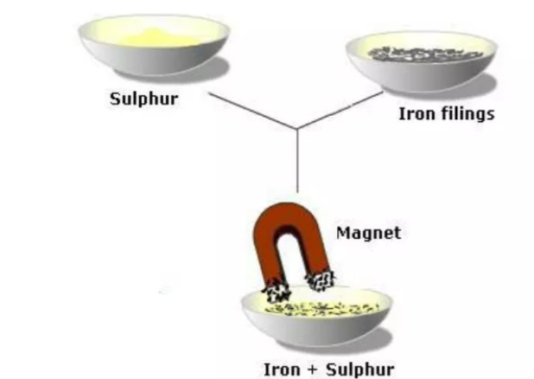
Magnetic separation can be applied on solid - solid mixtures, one of the solid is a magnetic material.

Slide 16
Thank You.

